Slide 1
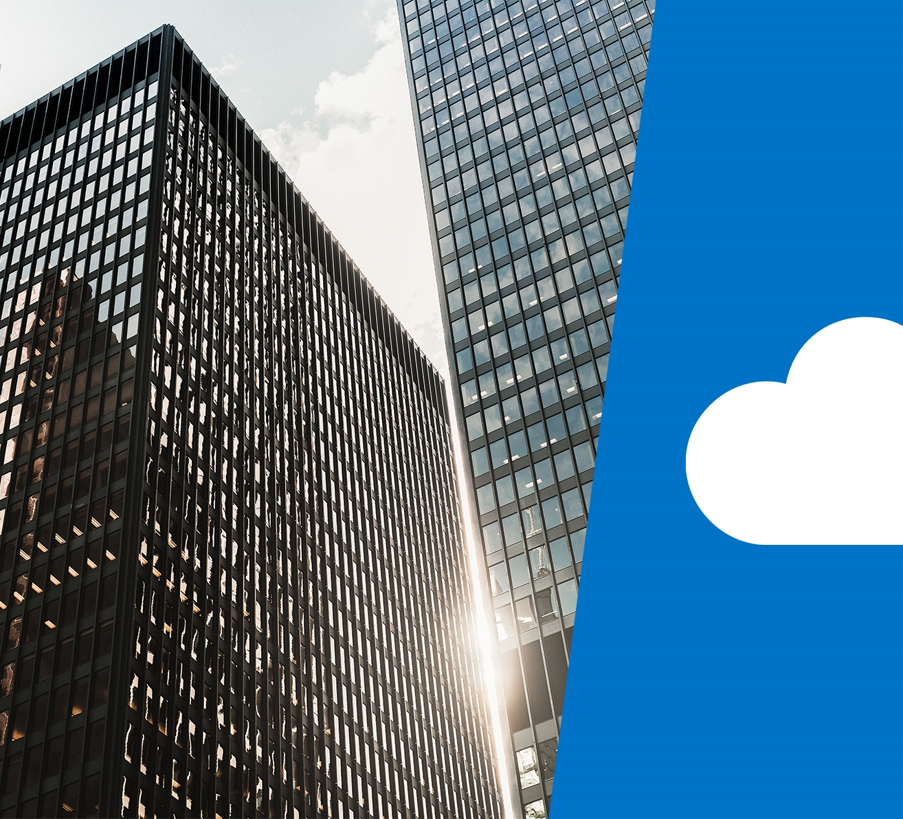
DP-201T01: Azure Architecture Considerations

Slide 2
Lesson Objectives
Describe the Pillars of a Great Azure Architecture
Design with Security in mind
Consider performance and scalability
Design for availability and recoverability
Design for efficiency and operations
Understand the course Case Study

Slide 3




Pillars of a Great Azure Architecture
Security
Performance
and Scalability
Shared Responsibility
Availability and Recoverability
Efficiency and
Operations
Notes:
Your role is not only to deliver business value through the functional requirements of an application and its data,
but to ensure the solution is designed in ways that are scalable, resilient, efficient and secure.
Solution architecture is concerned with the planning, design, implementation, and ongoing improvement of a technology system.

Slide 4
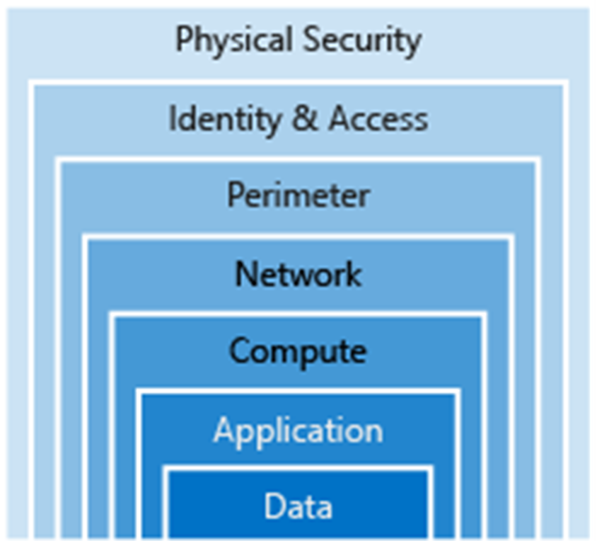
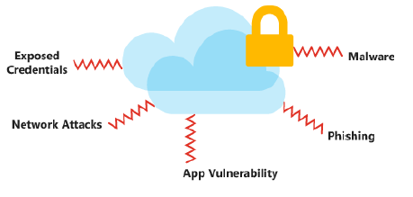
Design for Security.
Notes:
You'll be focused on securing access to your architecture through authentication and protecting your application and data from network vulnerabilities.
The integrity of your data should be protected as well, using tools like encryption.
The cloud provides protections against a variety of threats, such as network intrusion and DDoS attacks, but you still need to build security into your application, processes, and organizational culture

Slide 5
What should I protect?
Data may be subject to legal and regulatory requirements depending on
Where you are located
The type of data you are storing
The industry that your application operates in
HIPAA
PCI
GDPR
Some countries require that certain types of data do not leave their borders.

Slide 6
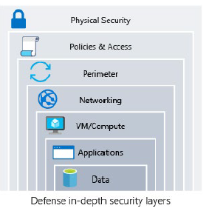
Common Attacks
Data layer: Exposing an encryption key or using weak encryption
Application layer: Malicious code injection and execution
VM/compute layer: Malware
Networking layer: Unnecessary open ports
Perimeter layer: Denial-of-service (DoS) attacks
Policies & access layer: Modern authentication protocols such as OpenID Connect, OAuth, or Kerberos.

Slide 7
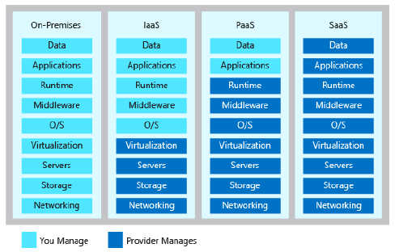
Shared responsibility
Notes:
Moving to the cloud introduces a model of shared responsibility
This shared responsibility will play a role in your architectural decisions, as they can have implications on cost, operational capabilities, security, and the technical capabilities of your application.
By shifting these responsibilities to your provider you can focus on bringing value to your business and move away from activities that aren't a core business function

Slide 8
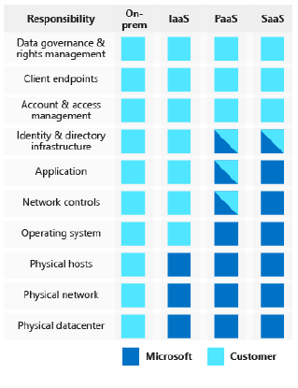
Shared responsibility
Notes:
Moving to the cloud introduces a model of shared responsibility
This shared responsibility will play a role in your architectural decisions, as they can have implications on cost, operational capabilities, security, and the technical capabilities of your application.
By shifting these responsibilities to your provider you can focus on bringing value to your business and move away from activities that aren't a core business function

Slide 9
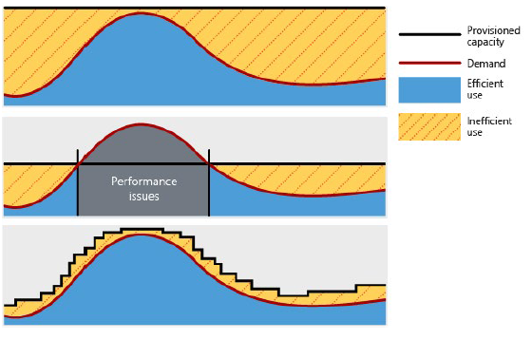
Design for Performance and Scalability
Notes:
Demand for services change, so it's important for your architecture to have the ability to adjust to demand as well.
By designing your architecture with performance and scalability in mind, you'll provide a great experience for your customers while being cost-effective.

Slide 10
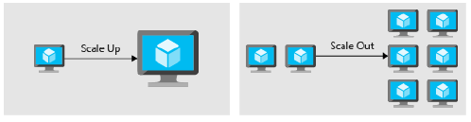
Design for Performance and Scalability
Scaling
Compute resources can be scaled in two different directions: * Scaling UP is the action of adding more resources to a single instance.
* Scaling out is the addition of instances.
Patterns and Practices
.
Partitioning
In many large-scale solutions, data is divided into separate partitions that can be managed and accessed separately
Scaling
Is the process of allocating scale units to match performance requirements. This can be done either automatically or manually
Caching
Caching is a mechanism to store frequently used data or assets (web pages, images) for faster retrieval
Performance
When optimizing for performance, you'll look at network and storage to ensure performance is acceptable. Both can impact the response time of your application and databases.
Notes:
The act of adding more capacity to the instance increases the resources available to your application, but it does come with a limit.
Virtual machines are limited to the capacity of the host they run on, and hosts themselves have physical limitations
The advantage of scaling out is that you can conceivably scale out forever if you have more machines to add to the architecture.
Scaling out requires some type of load distribution (load balancer / service discovery mechanism for identifying active servers to send requests to)
Partitioning can help improve scalability, reduce contention, and optimize performance
Autoscaling is the process of dynamically allocating resources to match performance requirements.
Autoscaling takes advantage of the elasticity of cloud-hosted environments while easing management overhead.
You can use caching between your application servers and a database, to decrease data retrieval times.
You could also use caching between your end users and your web servers, placing static content closer to the user and decreasing the time it takes to return web pages to the end user.

Slide 11
Design for Availability and Recoverability
Design for Availability
Design for Recoverability
Designing for availability focuses on maintaining uptime through small-scale incidents and temporary conditions like partial network outages.
Designing for recoverability focuses on recovery from data loss and from larger scale disasters.
Recovery Point Objective: The maximum duration of acceptable data loss.
Recovery Time Objective: The maximum duration of acceptable downtime
Notes:
Every architect’s worst fear is having your architecture go down with no way to recover it.
A successful cloud environment is designed in a way that anticipates failure at all levels. Both planned and un-planned.
Part of anticipating these failures is designing a system that can recover from the failure, within the time required by your stakeholders and customers
The goal is to add redundancy to components of the architecture so that you are less likely to experience an outage.
Examples of high-availability design components include clustering and load balancing.
Clustering replaces a single VM with a set of coordinated VMs.
Load balancing spreads requests across many instances of a service, detecting failed instances and preventing requests from being routed to them
Recovery Point Objective: The maximum duration of acceptable data loss. RPO is measured in units of time, not volume: “30 minutes of data”, "four hours of data", and so on. RPO is about limiting and recovering from data loss, not data theft.
Recovery Time Objective: The maximum duration of acceptable downtime, where “downtime” needs to be defined by your specification. For example, if the acceptable downtime duration is eight hours in the event of a disaster, then your RTO is eight hours.
With RPO and RTO defined, you can design backup, restore, replication, and recovery capabilities into your architecture to meet these objectives.

Slide 12
Design for Efficiency and Operations
Importance of efficiency and operations
Efficiency is focused on identifying and eliminating waste within your environment. The cloud is a pay-as-you-go service and waste typically comes from provisioning more capacity than demand requires. There are operational costs that go along with this as well. These operational costs show up as wasted time and increased error.
Efficiency best practices
Look at cost optimization steps like sizing data services or virtual machines properly and deallocating compute that aren't in use. Now that you are paying for what you use, you want to be sure that you aren't wasting any of these resources.
Operational best practices
Automate as much as possible. The human element is costly, injecting time and error into operational activities. You can use automation to build, deploy, and administer resources. By automating common activities, you can eliminate the delay in waiting for a human to intervene.
Notes:
You need to have a good monitoring architecture in place so that you can detect failures and problems before they happen or, at a minimum, before your customers notice.
You also need to have some visibility in to how your application is using its available resources, through a robust monitoring framework.
Waste can show up in several ways. Let's look at a few examples:
An Azure Synapse Analytics/Cosmos DB provisioned with too much SQL Pools/RTU than what is required
A virtual machine that is always 90% idle
Paying for a license included in a virtual machine when a license is already owned
Retaining infrequently accessed data on a storage medium optimized for frequent access
Manually repeating the build of a non-production environment
Where possible, you want to move from IaaS to PaaS services. PaaS services typically cost less than IaaS, and typically bring reduced operational costs along as well.
Automate as much as possible
Lastly, modern architectures should be designed with DevOps and continuous integration in mind

Slide 13
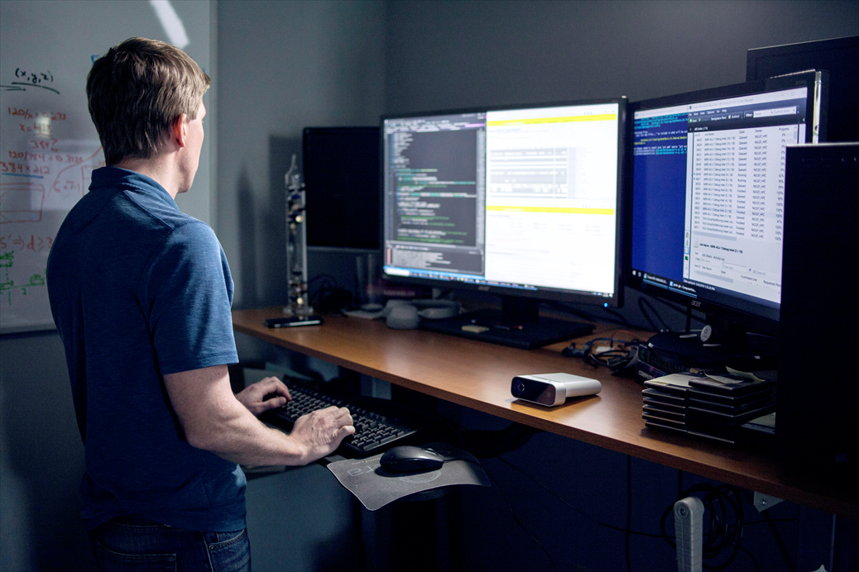
Lab: Architecture Considerations

Slide 14
Lab overview
The students will use the information gained in this module and apply it to a scenario that is defined in a case study about AdventureWorks. They will describe and provide examples of how the core principles for creating architectures will be applied to AdventureWorks.
This will include designing with security in mind. They will also provide specific examples of how to design performance and scalability within a solution. The students will also describe the availability and recoverability options that are needed by the organization. Finally, the student will identify the efficiency and operations opportunities that can be gained by the options
Lab objectives
After completing this lab, you will be able to:
1. Design with Security in mind
2. Design for Performance and Scalability
3. Design for Availability and Recoverability
4. Design for Efficiency and Operations

Slide 15
Lab scenario
You have been You have recently been hired as a senior data engineer at AdventureWorks and are working with a consultant and architects to design a cloud data platform solution that meets the organizations technical and business requirements.
Working in a group, you will be performing a discovery exercise – via a case study - with the consultant and architects. Firstly, to understand AdventureWorks organizational goals. Secondly to articulate and provide examples of the architectural aspects that the team must be aware of as they construct the solution architectures. The architectural aspects include security, performance, scalability, availability, recoverability, efficiency and operations.
At the end of this lab, you will have:
1. Design with Security in Mind
2. Design for Performance and Scalability
3. Design for Availability and Recoverability
4. Design for Efficiency and Operations

Slide 16
Documentation Reference
https://docs.microsoft.com/en-us/azure/architecture/data-guide/big-data/
https://docs.microsoft.com/en-us/azure/architecture/browse/
https://docs.microsoft.com/en-us/azure/architecture/data-guide/

Slide 17
Lab review
The Instructor will review the answers with the group.
The group will explore any gaps in requirements between the groups
Are there any requirements that couldn’t be categorized?
Are there any requirements that would require input from other roles in the organization?

Slide 18
Lab review
Exercise # | Requirement | Requirement type
1 | Only internal access allowed to the Azure Synapse | Security
1 | The connected bicycle must have secure connections to 1st and 3rd party applications | Security
2 | Customer Service and Presales need to scale using Bots (and store conversation history) | Scalability And Performance
2 | There is a requirement to scale the data warehouse system for the months of November and December | Scalability
2 | There is a requirement to scale the Sales/Ordering system for the months of November and December | Scalability

Slide 19
Lab review
Exercise # | Requirement | Requirement type
2 and 3 | A predictive analytics solution that is performant and resilient | Performance, Availability and Recoverability
3 | The Sales/Ordering system has a high availability requirement to ensure that it has continued operations | Availability
3 | The Sales/Ordering system has a data recoverability requirement of upto a day | Recoverability
3 | The predictive analytics solution has a data recoverability requirement of upto a day | Recoverability
4 | Regular automated data loads into Azure Synapse | Automation

Slide 20
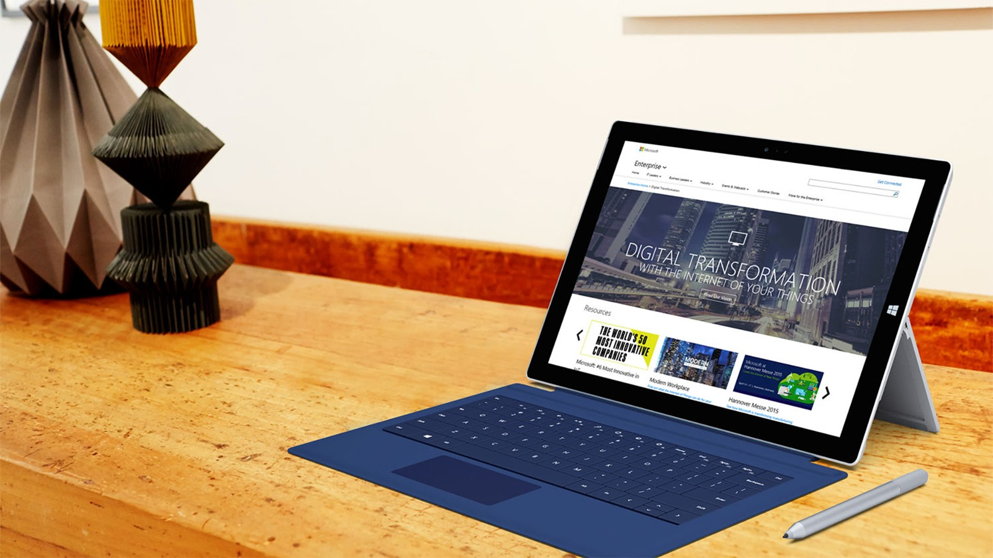
Next steps
Module Summary
In this module, you have learned about:
- Describe the Pillars of a Great Azure Architecture
- Design with Security in mind
- Consider performance and scalability
- Design for availability and recoverability
- Design for efficiency and operations
- Understand the course Case Study
After the course, consider visiting [the Microsoft Customer Case Study site. Use the search bar to search by an industry such as healthcare or retail, or by a technology such as Azure Cosmos DB or Stream Analytics. Read through some of the customers stories.

